Slide 1
Lecture-1
Post-Midterm

Slide 2
Agenda
Transformation of continuous random variables in two dimensions
Convergence of a Sequence of Random Variables and Limit Theorems:
Convergence in Probability and Convergence in Distribution,
Bernoulli’s Theorem, Law of Large Numbers.
Asymptotically Normal Distribution,
Limit Theorem for Characteristic Functions,
Central Limit Theorem,
DeMoivre Laplace Limit Theorem.

Slide 3
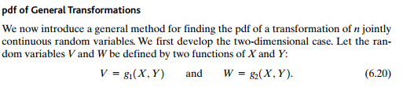


Slide 4

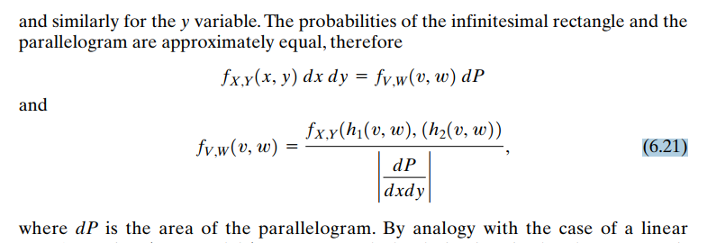

Slide 5
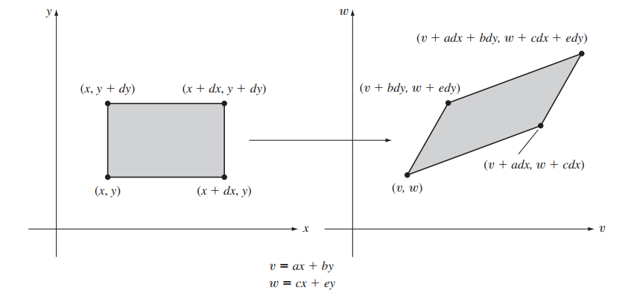
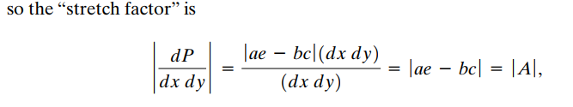


Slide 6
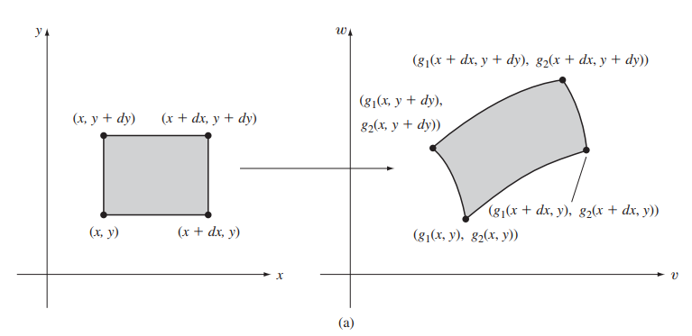

Slide 7
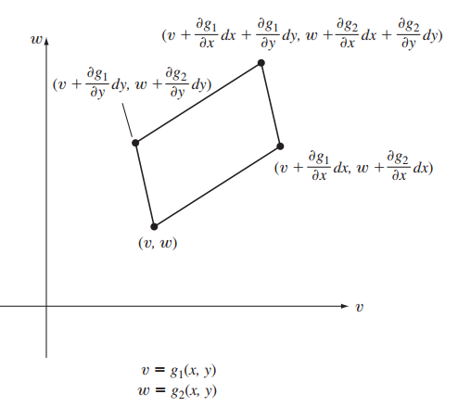

Slide 8
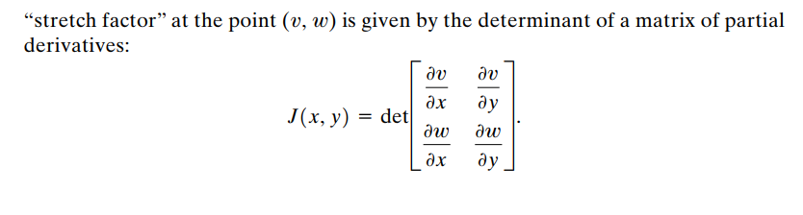


Slide 9
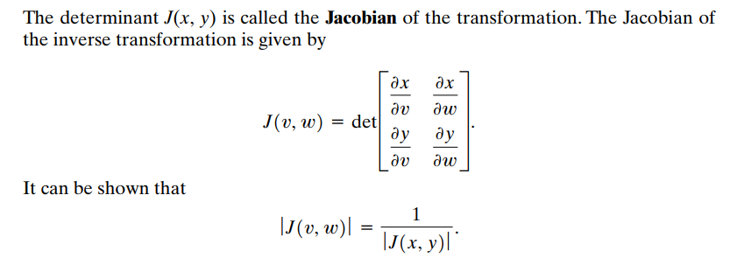




Slide 10



Slide 11
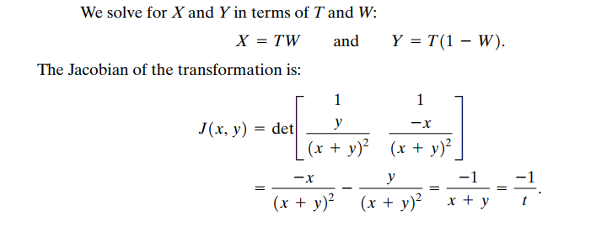

Slide 12
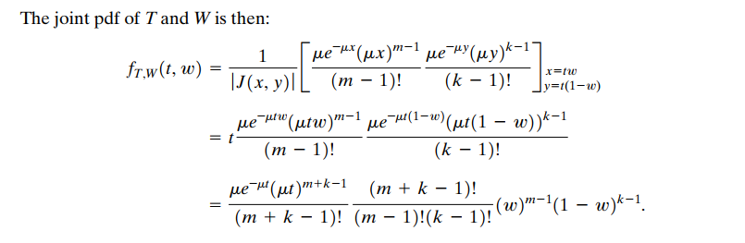

Slide 13
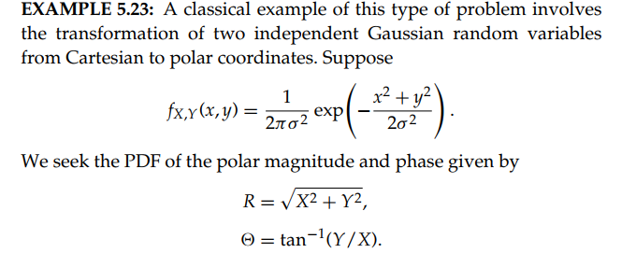
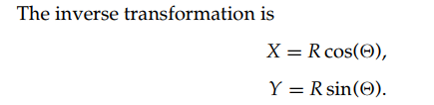

Slide 14
